Slide 1

The Amazon Black Friday Rush: Overseeing the E-Commerce Surge
CC BY

Slide 2
INTRODUCTION
Many stores offer highly promoted sale discounted prices and often open early sometimes as early as mid night or even thanks giving.
Investors closely monitor the marketing approaches adopted by different companies to anticipate the profitability of the business.
Amazon establish internet platform sales & strategic processing ecommerce delivery worldwide.

Slide 3
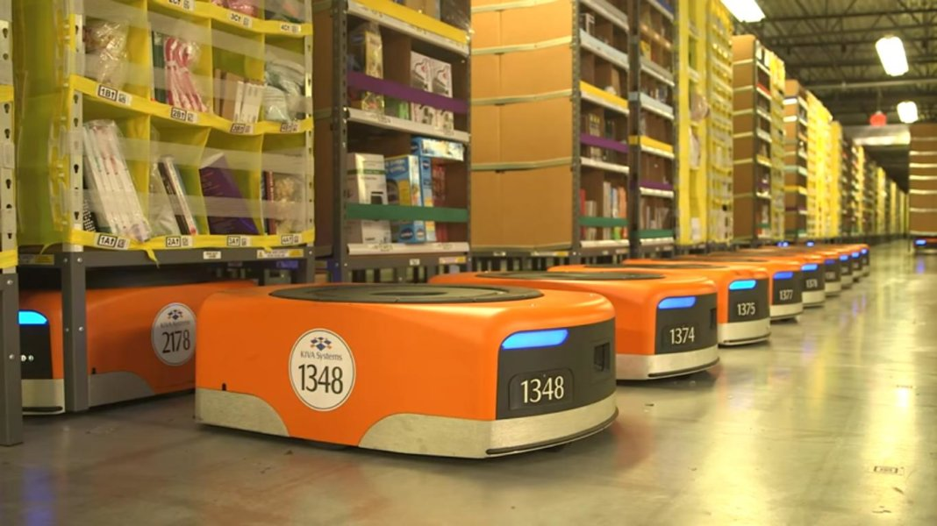

objective and scope
The aim of this simulation is to create a thorough plan to manage the high demand during black Friday for an online retail company.
The scope of this simulation covers three critical areas :
Demand forecasting
streamlined delivery
Ware house optimization

Slide 4
Problem statement
Forecasting demands : demands for numerous products can pose challenges & stock shortages or excess inventory.
Challenges in warehouse optimization : large numbers of orders may strain picking systems orders processing efficiency without proper optimization.
Issues with logistics coordination fulfilling delivery commitments prove to be difficult impacting customer contentment.

Slide 5
methodology
Utilized advanced analytics machine learning models automated warehouse systems and route optimization software to enhance demand forecasting warehouse efficiency and delivery coordination.

Slide 6

Demands forecasting
Implemented machine learning models to predict product demand
accurately reducing stockouts and overstocking.
This Photo by Unknown Author is licensed under CC BY-SA-NC

Slide 7
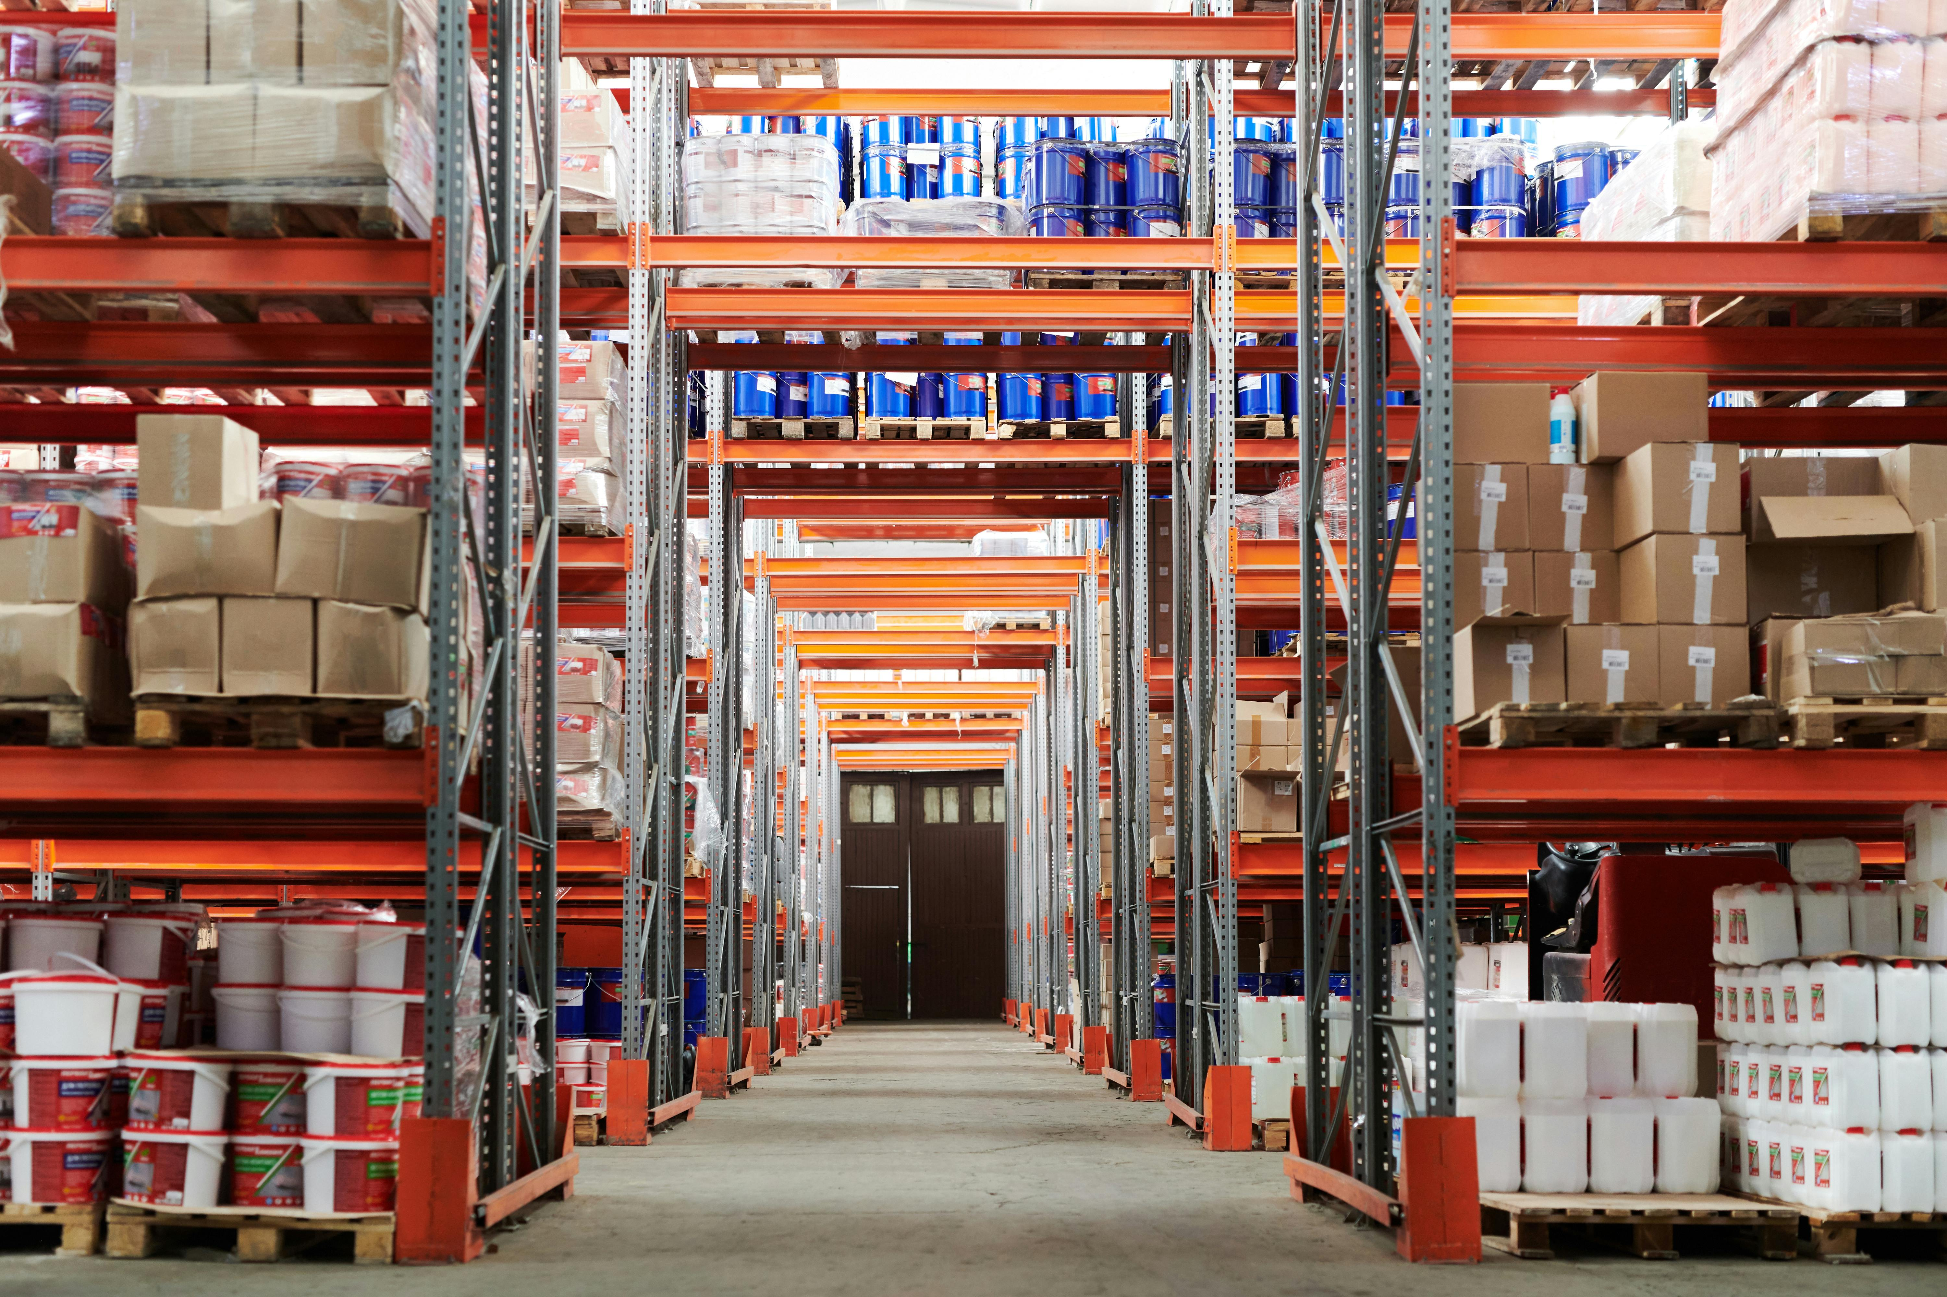
warehouse optimization
Enhanced warehouse operations with automated systems and optimized layouts increasing picking and packing efficiency.

Slide 8
Challenge and solutions
1.Demand Forecasting Issues
Data Quality and Availability:
Issue: incomplete or inaccurate historical sales data can hinder the development of reliable forecasting models
Resolution: Ensure data quality by cleansing and validating historical sales data. Incorporate market trends and consumer sentiment analysis to enrich the date .
2. Warehouse Efficiency
Problems Picking and Packing Efficiency:
Problem: High order volumes can overwhelm manual picking and packing processes, leading to delays and errors.
solution: Deploy automated picking systems, such as robotic pickers and conveyor belts, to increase efficiency.

Slide 9

Logistics coordination
Streamlined delivery processes using route optimization software and strong carrier partnership to ensure timely and cost effective deliveries.

Slide 10
conclusion
In summary, effectively handling the Black Friday rush is essential for e-commerce giants like Amazon, considering the significant sales volume and customer demands during this peak period. This project highlights the significance of a holistic strategy that combines demand forecasting, warehouse optimization, and efficient delivery to address the complexities of Black Friday operations

Slide 11
Thank you
P. Nihaswi
pedapatlorinihaswireddy@gmail.com

